Slide 1
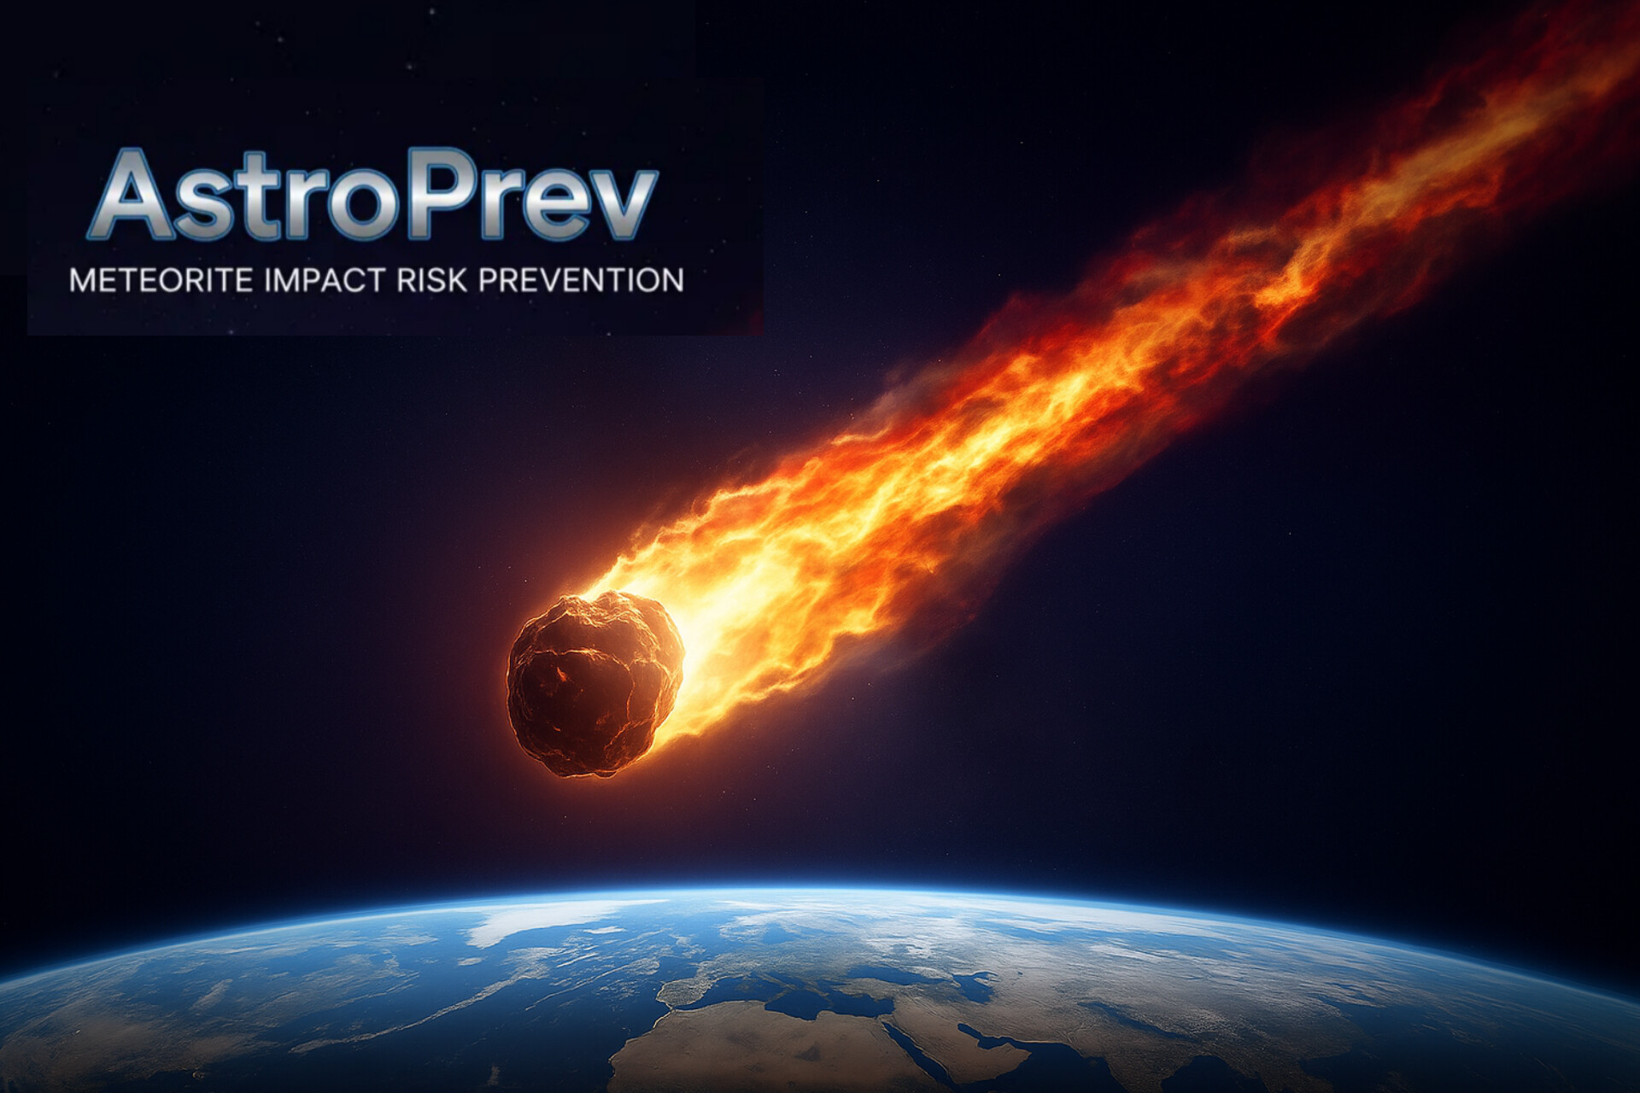
AI GENERATED

Slide 2
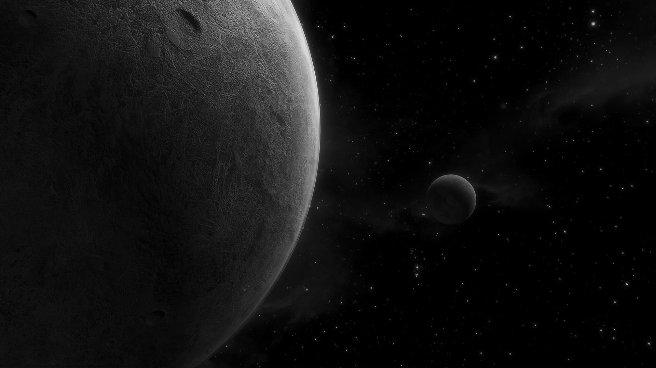
Meteorite impact risk
01
Problem
Problem

Slide 3
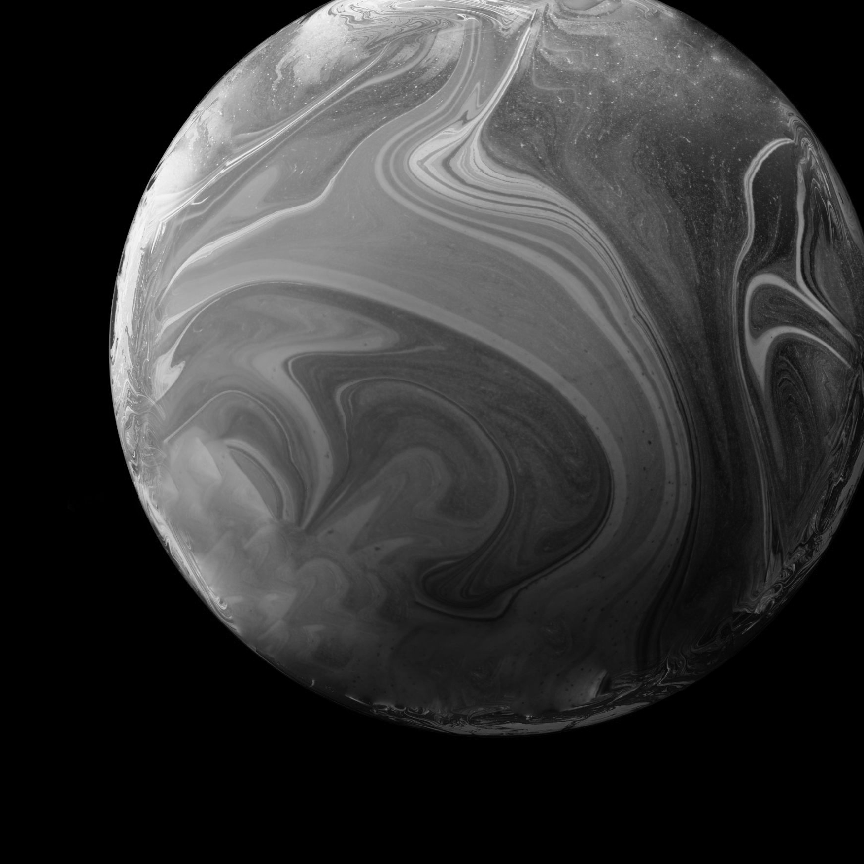
02
Solution
Risk prevention
Early reaction

Slide 4
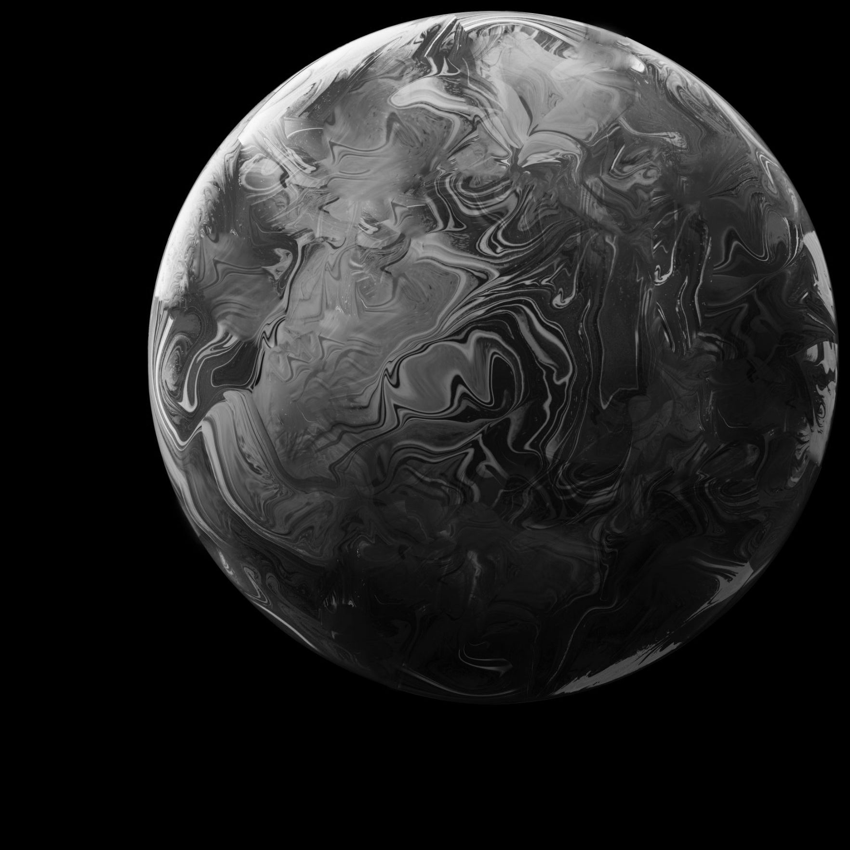
03
Goal
Aid governments in decision making and disaster planning

Slide 5
Shadow analogy
Near
Far
04
Problem | Value | Solution
Low predictibility | Impact Data/asteroid ‘s composition | Preparedness Options Awareness
Alarmist news | Accesible UI | Clear communication
Problem | Value | Solution
Asteroid Impact | Information about direct and indirect consequences | Movilization of resources and readyness

Slide 6
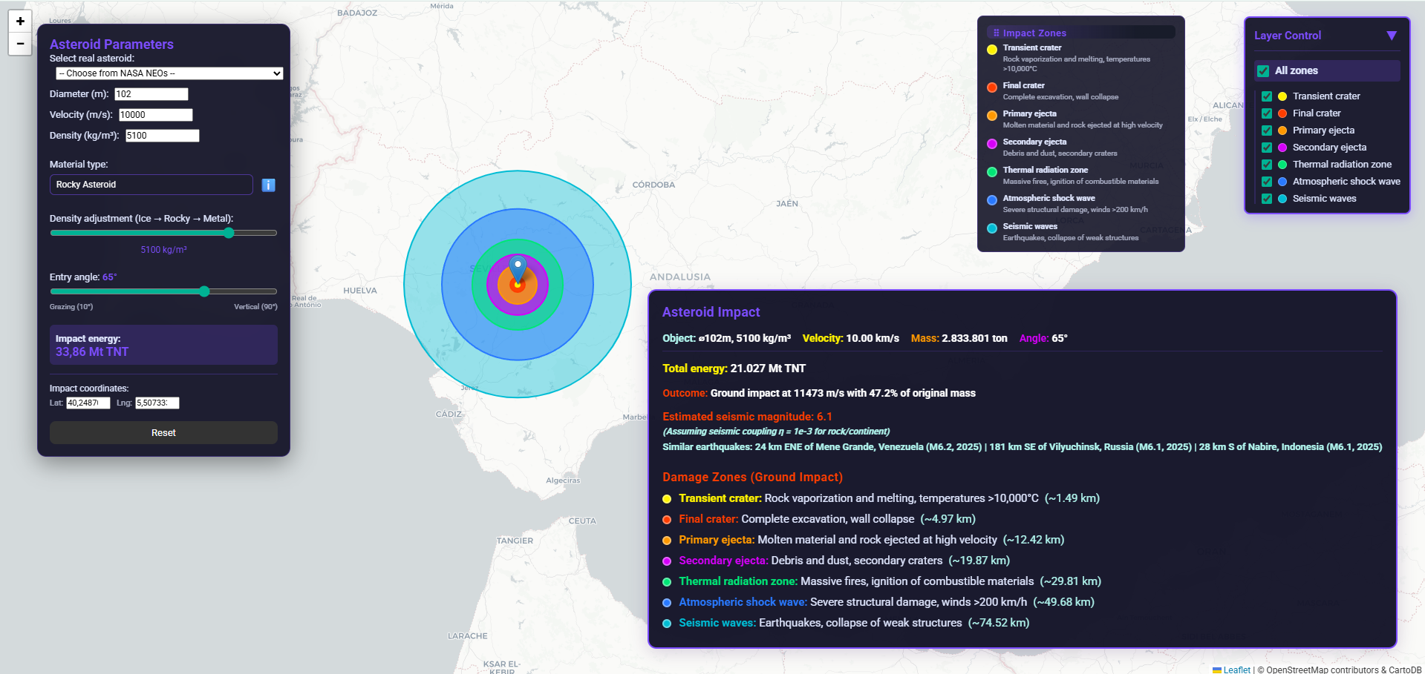

Slide 7


THANKS!
DEMO: astroprev.earth
AI GENERATED

